Slide 1
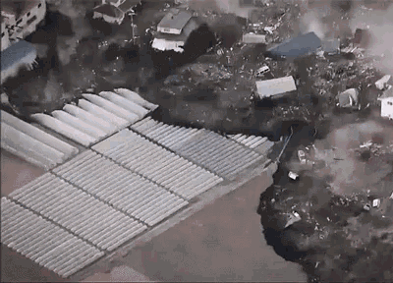
TSUNAMI PREDICTION USING MACHINE LEARNING TECHNIQUES
Group #1
Jack McMorrow, Alex Khater,
Alejandra Mejia
Source: Tenor

Slide 2
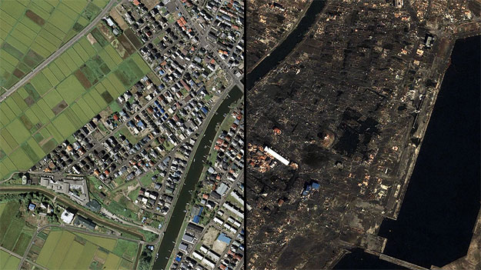
Why Tsunami prediction?
According to the WHO, tsunamis have caused of 250,000 deaths between 1998-2017
According to the IMF, the 2011 tsunami in Japan caused between 200 and 300 billion dollars in damages
Over 700 Million people live in high risk areas for tsunamis
Early warning systems are key to minimizing damage and loss of life
Tsunamis can be difficult to predict, given the many factors that contribute toward their formation.
Before and After Photo from the 2011 Japanese Tsunami
Source: https://aqworks.com/en/blog/2011/03/23/infographics-roundup-2011-tohoku-earthquake-and-tsunami/

Slide 3
About the dataset
The dataset used in the current project was retrieved from Kaggle and contains data records of 782 different earthquakes.
It contains information about various earthquakes that have occurred from 2001 to 2022.
It contains 18 different columns including:
Geo-location data
Earthquake Magnitude and Projected Damage
Various measurement metrics showing what predictive data was available and how extensive it was at the time of the event
Date/Time Data
Our target variable: a binary variable showing whether or not a tsunami was caused

Slide 4
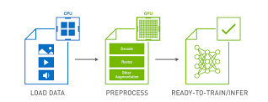
Quick Pre-Processing Rundown
Dropped the columns ‘Alert’, ‘Country’ and ‘Continent’ due to high quantity of null value
Removed Outliers per the mean+3*standard Deviation formula
Dropped ‘Title’ because of lack of usage for modeling
Decided against PCA because of low multicollinearity concerns and low dimensionality
Applied a Kolmogorov-Smirnov test for normality found non- normal data in most of our columns.
Image Source: NVIDIA developers

Slide 5
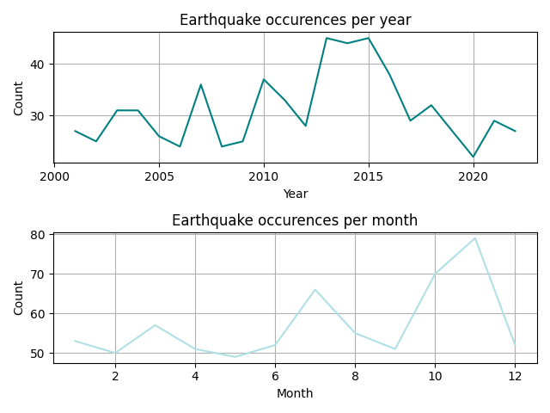
EDA
The most common magnitude in earthquakes is actually 6.5 and only a few number of instances a magnitude greater than or equal to 8.0 has been observed
The years 2013 and 2015 saw the most number of earthquakes,
The month of November seems to be the one with more recorded occurrences
Interesting insight into considering adding variables in future research related to specific environmental factors that occur during those years or in that month, like sea level rise.
Distribution of earthquake magnitude in the sample
Earthquakes occurrence per year and month

Slide 6
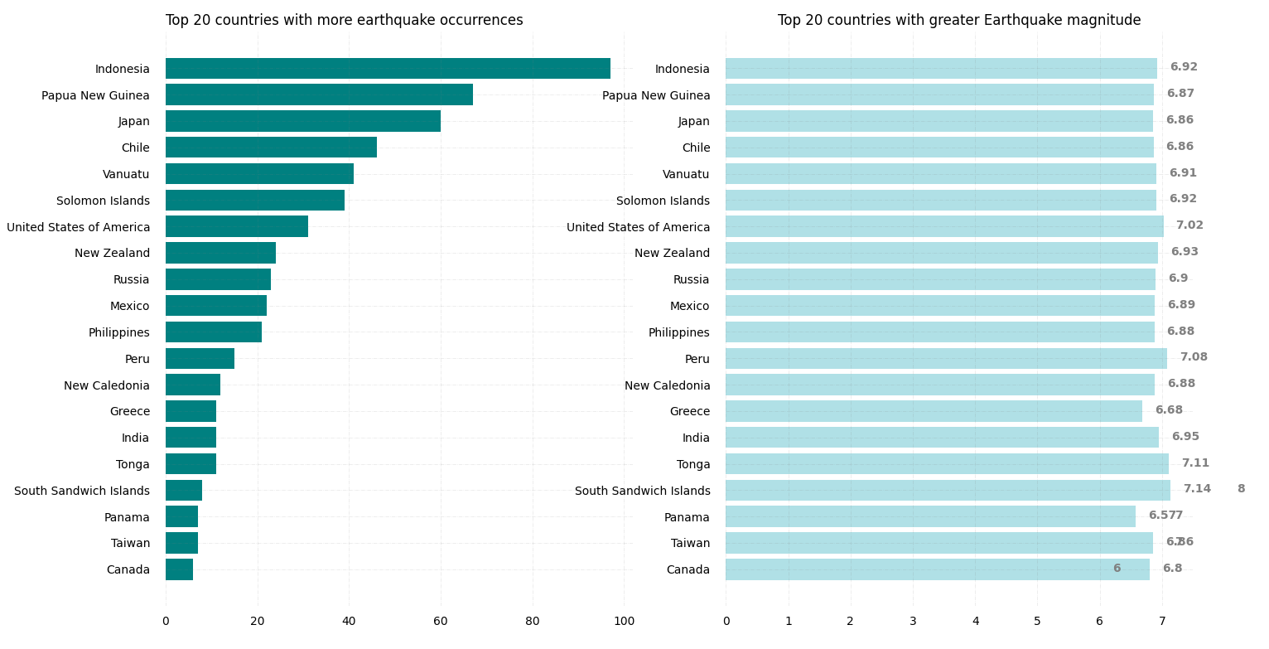
EDA
Events are spread out in different continents:
Indonesia has the highest number of earthquakes.
On average a higher number of earthquakes does not mean a higher magnitude.

Slide 7

Earthquakes 2001-2022

Slide 8
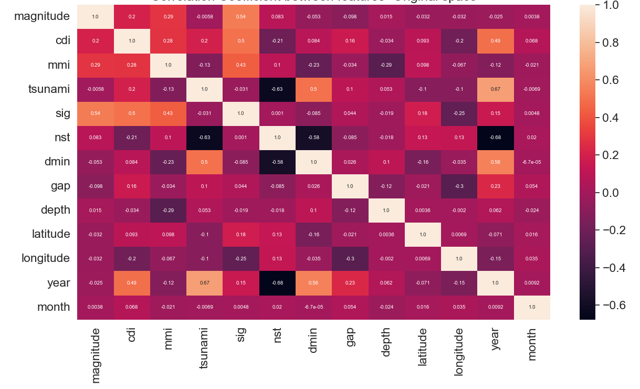
EDA
Slightly unbalanced with 37 percent of tsunamis occurrences against 63 percent of occurrence with earthquakes but no tsunamis.
Features were not correlated between them or with our target variable.
T- test indicated non-significant p- values which indicated low levels of correlation

Slide 9
Considerations for model selection
Alignment with project goal
ML algorithms can handle multidimensional, large (ML) volumes of data usually occurring in thematics related to disaster and pandemic management.
Been used to better cope with the severe and often catastrophic impacts of disasters
More effective at handling complicated and nonlinear high-dimensional data sets
2. Dataset Size: dataset is not extremely big
3. Dimensionality
No abundant features, no multicollinearity ~ non-complex NN
4. Inference time: SVM simple and faster, XGBoost faster than AdaBoost
5. Train Test Split: We decided on a 67-33 split for our training and testing set using Sklearn and Keras

Slide 10
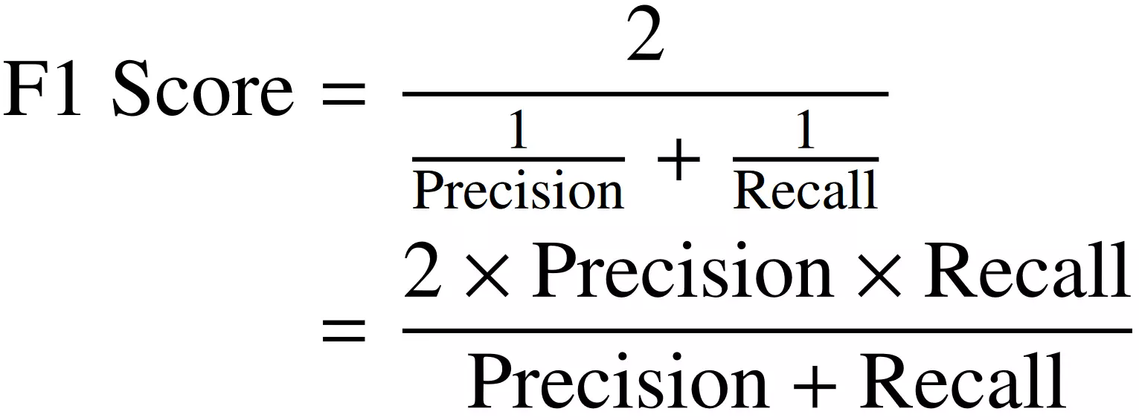
A Note on Model Evaluation
The metric we are primarily using to evaluate our models is the F1 Score
Our data is slightly imbalanced
Because we mainly care about the positive case (Not much penalty to falsely positives relative to false negatives) the F1 score is the other metric
We will be showing other metrics (including ROC_AUC), but F1 score is the one we are primarily concerned with
Image Source: https://www.v7labs.com/blog/f1-score-guide

Slide 11
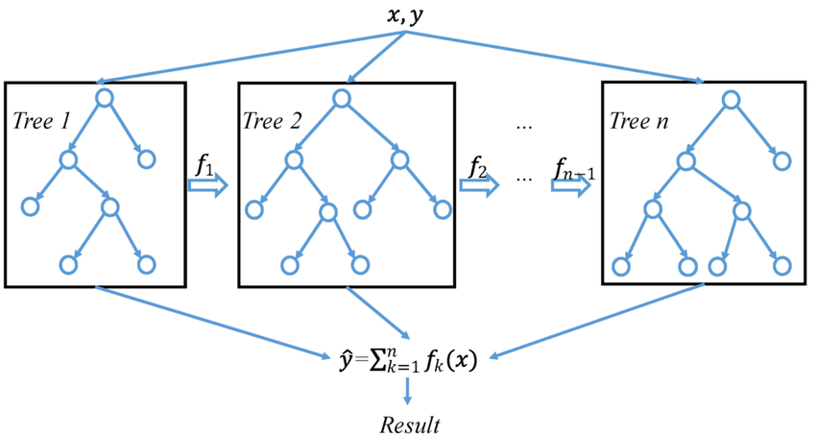
A Brief Overview of XGBOOST
Stands for “Extreme Gradient Boosting”
Builds a series of weak decision tree models in parallel and forms them level by level
The final model is a weighted sum of all tree predictions
It is called gradient boosting because it uses a gradient descent algorithm.
Very simply put: XGBOOST uses a collection of parallel built decision trees to create a model
A brief overview of the XGBOOST algorithm
Image Source: https://www.researchgate.net/figure/A-general-architecture-of-XGBoost_fig3_335483097

Slide 12
Why XGBOOST
Very Powerful and Flexible
Does not need extensive pre-processing
Does not require normal data because it is a composite of decision tree models
Easy to Use
Has been dominating Kaggle competitions recently
Image Source: https://www.researchgate.net/figure/A-general-architecture-of-XGBoost_fig3_335483097

Slide 13
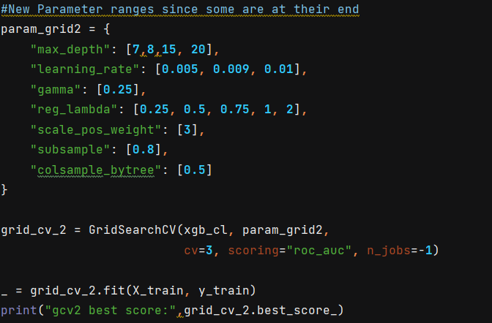
Our XGBOOST Model
We used Gridsearch_CV
It is a cross validation method that tests various values for hyperparameters from a predefined dictionary to find the optimal model performance
An example from our code of using GridSearch CV

Slide 14
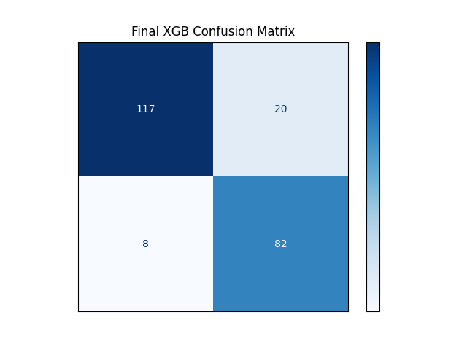
Our XGBoost Results
Method | Precision | Recall | ROC_AUC | F1 Score
MLP | 0.7591 | 0.8814 | 0.8616 | 0.8156
XGBoost | 0.8540 | 0.9360 | 0.9514 | 0.8932

Slide 15
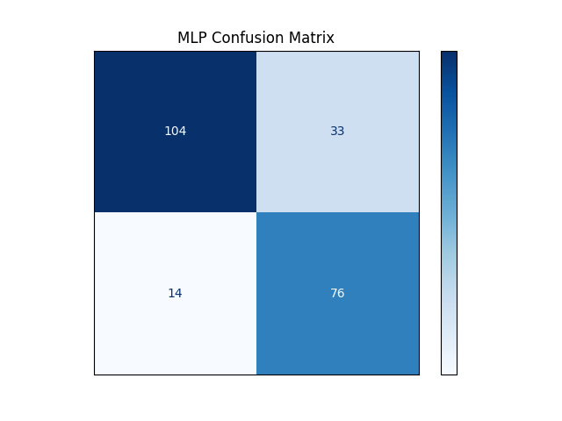
Basic MLP
We will be using a basic, untuned and unmodified MLP from Sklearn as a comparison for our other models.
The point of this model is to serve as a comparison to the more advanced models we will be using for this project. Here is its confusion matrix:
Method | Precision | Recall | ROC_AUC | F1 Score
MLP | 0.7591 | 0.8814 | 0.8616 | 0.8156

Slide 16
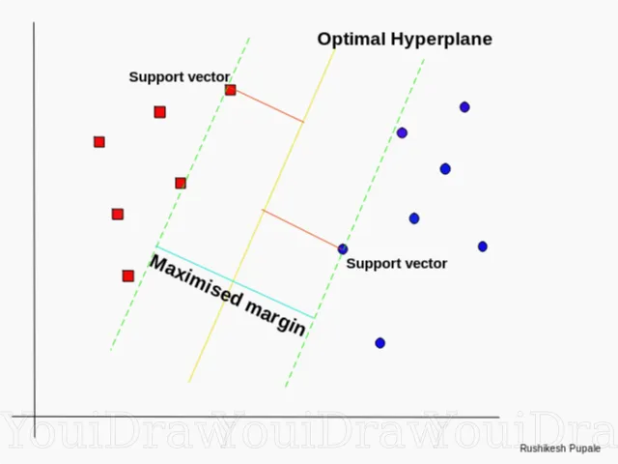
A Brief Overview of SVM
Linear Classifier
Uses selected points of each class as “support vector”s to increase a margin
Well Suited to High Dimensional Data
Struggles with Large Datasets
Source: https://towardsdatascience.com/https-medium-com-pupalerushikesh-svm-f4b42800e989

Slide 17
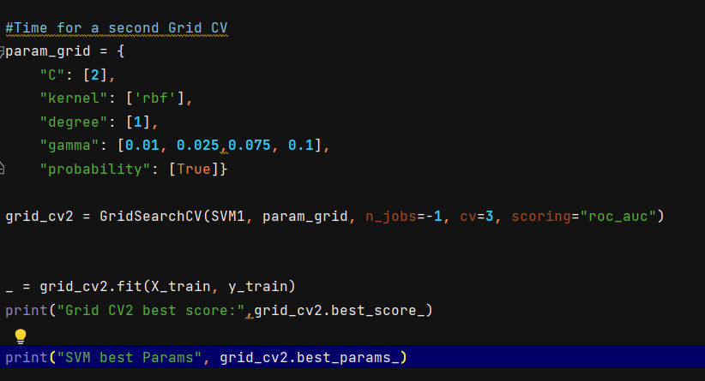
Our SVM Model
We used Gridsearch_CV
It is a cross validation method that tests various values for hyperparameters from a predefined dictionary to find the optimal model performance
An example from our code of using GridSearch CV on the SVM

Slide 18
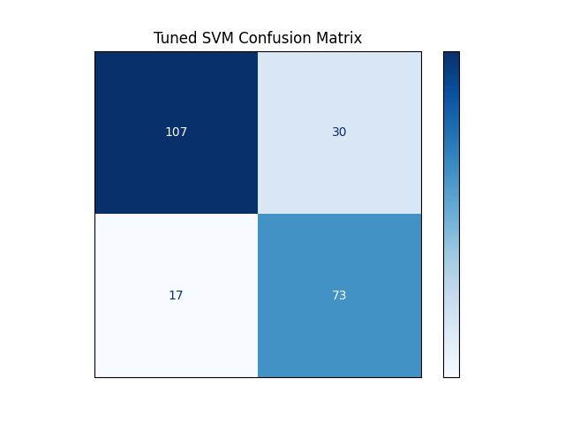
Our SVM Results
Method | Precision | Recall | ROC_AUC | F1 Score
XGBoost | 0.8540 | 0.9360 | 0.9514 | 0.8932
MLP | 0.7591 | 0.8814 | 0.8616 | 0.8156
SVM | 0.7810 | 0.8629 | 0.8716 | 0.819

Slide 19
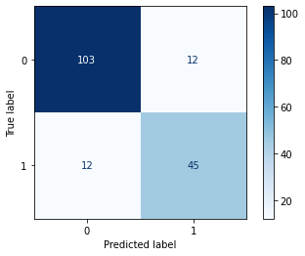
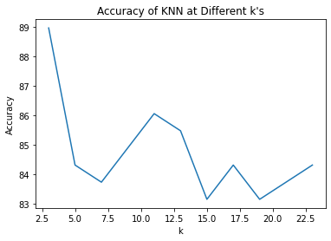
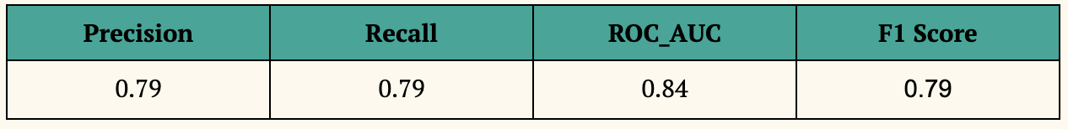
KNN Model
We also implemented a K-Nearest Neighbors model to classify the data
We chose a k value of 11 for our final model.

Slide 20
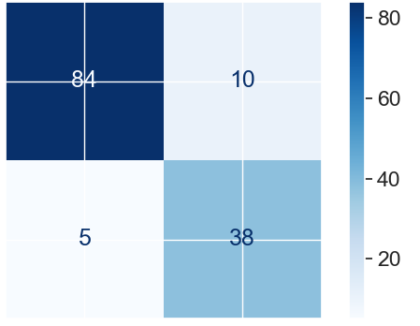
Random Forest Model
Decision trees and neural network algorithms can fall very easily in the overfitting
RF: Good scalability and ease of use, more robust and less susceptible to overfitting, no issue with multicollinearity
Initializing 100 n_estimators , max_depth of none.
Randomized search best hyperparameters max depth of 19 and 495 as n_estimators
Precision | Recall | ROC_AUC | F1 Score
0.7966 | 0.9216 | 0.8910 | 0.8545
Notes:
average the high variance that individual trees suffer
An additional advantage of using random forest relies in not requiring the need of choosing good hyperparameter values given ensemble models are robust to noise.
(the nodes are expanded until all leaves are pure or until all leaves contain less than min_samples_split samples.)
F1 score is a machine learning evaluation metric that measures a model's accuracy. It combines the precision and recall scores of a model. The accuracy metric computes how many times a model made a correct prediction across the entire dataset.
The ROC AUC score tells us how efficient the model is. The higher the AUC, the better the model's performance at distinguishing between the positive and negative classes. aCCEPTABLE DISCRIMINATION. Precision can be seen as a measure of quality, and recall as a measure of quantity

Slide 21
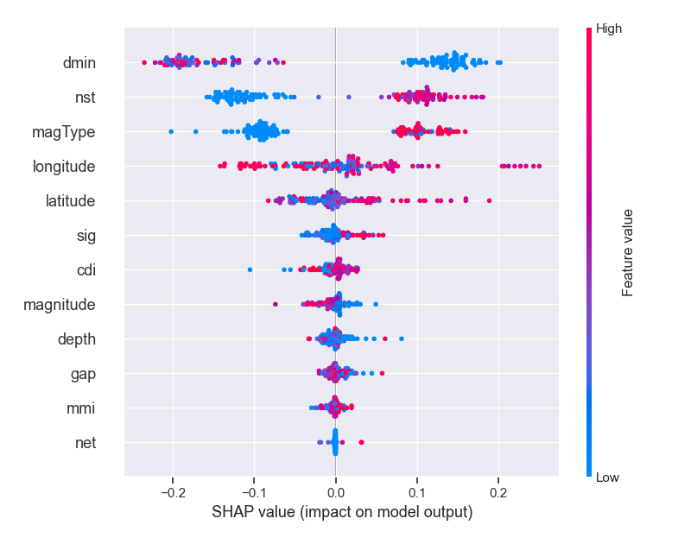
Random Forest Model
SHAP values relies on them being model-agnostic and being able to get an overview of which features are most important for a model.
SHAP values to show the distribution of the impacts each feature has on the model output.
High dmin (horizontal distance from the epicenter to the nearest station) lowers the predicted tsunami probability.
Notes:
SHAP values (SHapley Additive exPlanations) is a method based on cooperative game theory and used to increase transparency and interpretability of machine learning models
nst= The total number of seismic stations used to determine earthquake location.
It requires much computational power as well as resources as it builds numerous trees to combine their outputs.
It also requires much time for training as it combines a lot of decision trees to determine the class.
Due to the ensemble of decision trees, it also suffers interpretability and fails to determine the significance of each variable.

Slide 22
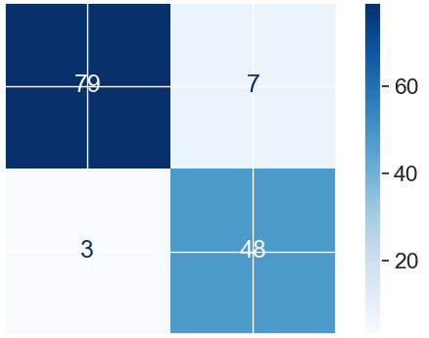
AdaBoost Model
Trains weak models and gives higher priority to the observations predicted incorrectly by previous models.
Often much better at making accurate classifications.
Initialized with 100 n_estimators and decision tree like the base_estimator.
Best hyperparameters for the model were a learning rate of 0.1 and 100 as number of estimators.
Precision | Recall | ROC_AUC | F1 Score
0.8727 | 0.9412 | 0.9299 | 0.9057
Notes:
Random Forest uses parallel ensembling while Adaboost uses sequential ensembling. Random Forest runs trees in parallel, thus making it possible to parallelize jobs on a multiprocessor machine. Adaboost instead uses a sequential approach.
AdaBoost minimises loss function related to any classification error and is best used with weak learners. The method was mainly designed for binary classification problems and can be utilised to boost the performance of decision trees. AdaBoost is slower than the XGBoost.

Slide 23
Summary of Results
Method | Precision | Recall | ROC_AUC | F1 Score
XGBoost | 0.8540 | 0.9360 | 0.9514 | 0.8932
MLP | 0.7591 | 0.8814 | 0.8616 | 0.8156
KNN | 0.79 | 0.79 | 0.84 | 0.79
SVM | 0.7810 | 0.8629 | 0.8716 | 0.819
Random Forest | 0.7966 | 0.9216 | 0.8910 | 0.8545
AdaBoost | 0.8727 | 0.9412 | 0.9299 | 0.9057
Notes:
Random Forest uses parallel ensembling while Adaboost uses sequential ensembling. Random Forest runs trees in parallel, thus making it possible to parallelize jobs on a multiprocessor machine. Adaboost instead uses a sequential approach.
AdaBoost minimises loss function related to any classification error and is best used with weak learners. The method was mainly designed for binary classification problems and can be utilised to boost the performance of decision trees. AdaBoost is slower than the XGBoost.

Slide 24
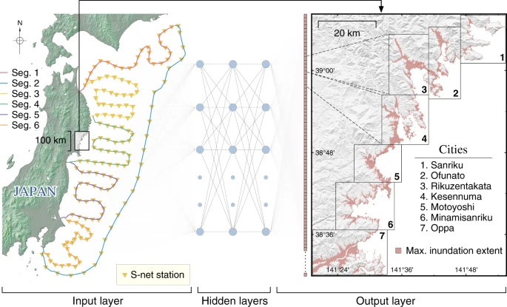
Limitations and future studies
3 Primary Limitations To Be Addressed:
Lack of Deep Learning/ more advanced models
Usage of More Advanced Seismic Data
Lack of information on tsunami severity
Image / graph/ table
Image from the more complex RIKEN Pioneering Project
Study using advanced Seismographic Data and Models

Slide 25
Thank you!
Questions?

